Slide 1
ETHICAL HACKING
ALEESHA KURIAN
S2 MCA

Slide 2
CONTENTS
Introduction
Ethical Hacking
Hackers
Types of Hackers
Hacking Process
Required Skills of an Ethical Hacker
Advantages
Disadvantages
Future Enhancements
Conclusion

Slide 3
INTRODUCTION
Ethical hacking also known as penetration testing or white-hat hacking, involves the same tools, tricks, and techniques that hackers use,but with one major difference that Ethical hacking is legal.

Slide 4
ETHICAL HACKING
‘Ethical hacker’ refers to security professionals who apply their hacking skills for defensive purpose.
Neither damage the target systems nor steal information.
Evaluate target systems security and report back to owners about the vulnerabilities found.

Slide 5
HACKERS
A person who enjoys learning details of a programming language or system
A person who enjoys actually doing the programming rather than just theorizing about it
A person capable of appreciating someone else's hacking
A person who picks up programming quickly
A person who is an expert at a particular programming language or system

Slide 6
Types of Hackers
1.Black-Hat Hacker
A black hat hackers or crackers are individuals with extraordinary computing skills, resorting to malicious or destructive activities.
That is black hat hackers use their knowledge and skill for their own personal gains probably by hurting others.
2. White-Hat Hacker
White hat hackers are those individuals professing hacker skills and using them for defensive purposes.
This means that the white hat hackers use their knowledge and skill for the good of others and for the common good.

Slide 7
3.Grey-Hat Hackers
These are individuals who work both offensively and defensively at various times.
We cannot predict their behavior.
Sometimes they use their skills for the common good while in some other times he uses them for their personal gains.

Slide 8
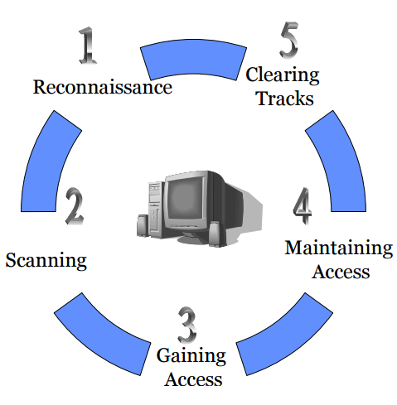
HACKING PROCESS
Foot Printing/Reconnaissance
-Active/passive
Scanning & Enumeration
-Blue print of the target
-Different tools are used:
-TCP protocol
-What resources &shares
found in system

Slide 9
Gaining access
-Actual hacking
-Access password
Maintaining access
-Uploading/altering/downloading programs or data
Clearing tracks
-Deletion of all logs.

Slide 10
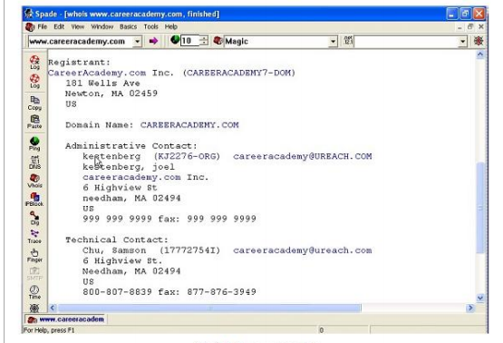
ETHICAL HACKING TOOLS
Samspade

Slide 11
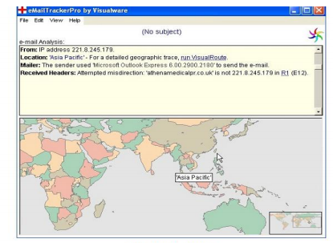
Email Tracker

Slide 12
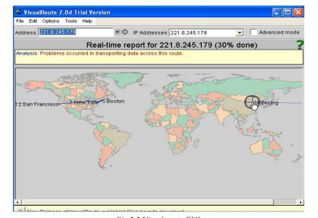
Visual Route

Slide 13
Required Skills of an Ethical Hacker
Microsoft: skills in operation, configuration and management.
Linux: knowledge of Linux/Unix; security setting, configuration, and services.
Firewalls: configurations, and operation of intrusion detection systems
Routers: knowledge of routers, routing protocols, and access control lists
Mainframes
Network Protocols: TCP/IP; how they function and can be manipulated.
Project Management: leading, planning, organizing, and controlling a penetration testing team

Slide 14
ADVANTAGES & DISADVANTAGES
Advantages
Disadvantages
Helps in closing the open holes in the system network
Provides security to banking and financial establishments
Prevents website defacements
An evolving technique
All depends upon the trustworthiness of the ethical hacker
Hiring professionals is expensive.

Slide 15
FUTURE ENHANCEMENTS
As it an evolving branch the scope of enhancement in technology is immense.
No ethical hacker can ensure the system security by using the same technique repeatedly.
More enhanced software’s should be used for optimum protection.

Slide 16
CONCLUSION
In the preceding sections we saw the methodology of hacking, why should we aware of hacking and some tools which a hacker may use.
Now we can see what can we do against hacking or to protect ourselves from hacking.
The first thing we should do is to keep ourselves updated about those software’s we and using for official and reliable sources.
Educate the employees and the users against black hat hacking

Slide 17
REFERENCES
www.google.com
www.studymafia.org

Slide 18
THANK YOU

